Slide 1
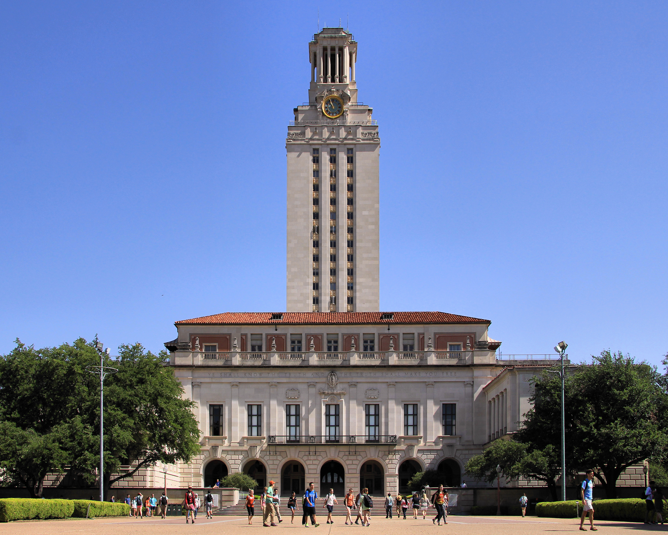


PGP
Artificial Intelligence
& Machine Learning

Slide 2
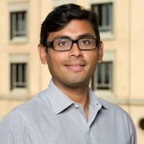
Harish Subramanian
Director at Great Learning
MBA from Kellogg School of Management
MS from The University of Texas, Austin Machine Learning, Intelligent Robotics & AI
In Education for over 6 years
Formerly at Boston Consulting Group - New York, Toronto and Johannesburg Offices
Built Algorithms at Murex in N. America & E. Asia

Slide 3
About Great Learning
India’s leading ed-tech company focused on helping professionals upskill themselves
On a mission to make every professional future proficient
Offering 12 top ranked programs catering to 15,000+ professionals annually.
Robust technology platform and program management capabilities
Delivered 8 million+ learning hours in analytics, data science and ML / AI

Slide 4





Our academic partners

Slide 5
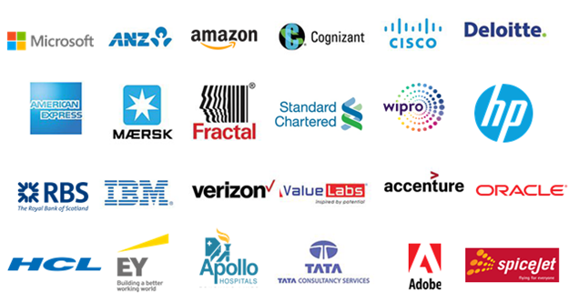
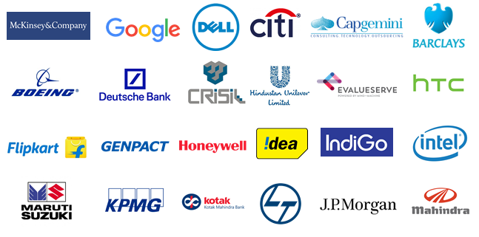
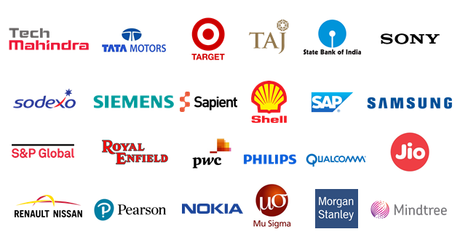

Where do our alumni work?

Slide 6

What do you envision, when you hear
‘Artificial Intelligence’?

Slide 7

A super-intelligent, humanoid robot?

Slide 8
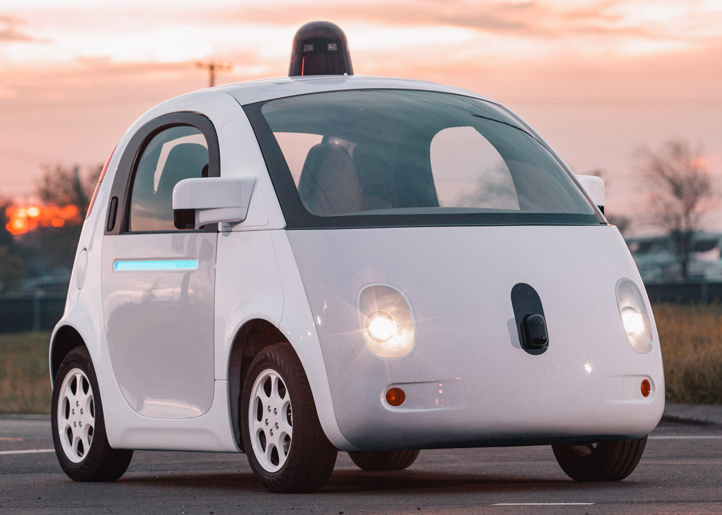
A self-driving car?
Google’s Waymo

Slide 9
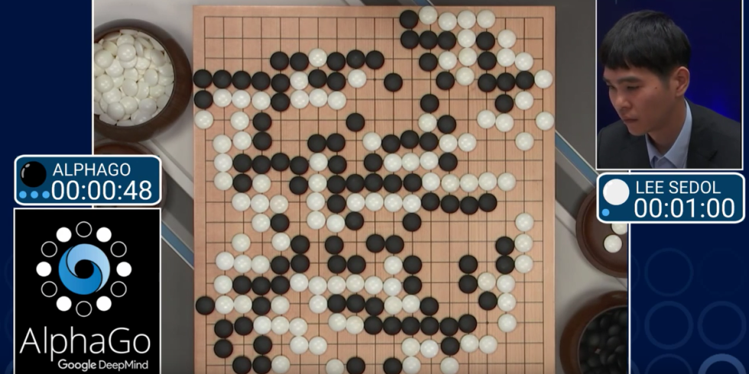
Or an algorithm that challenges the human intellect?

Slide 10
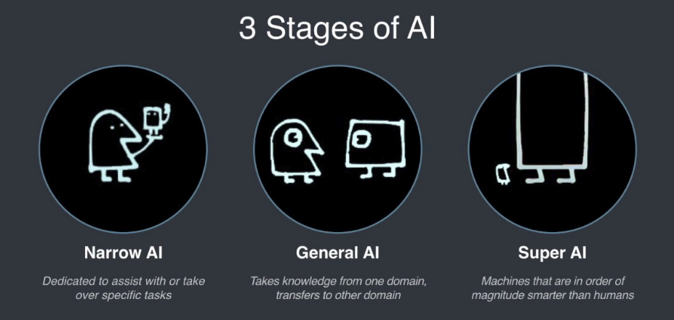
What do we mean we say AI?
Source: Frank Chen @ a16z, “AI: What’s working and what’s not”

Slide 11
Super AI?
“I worry about Super AI in the same way that I worry about overpopulation on Mars.”
- Andrew Ng

Slide 12
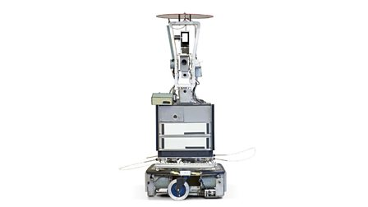
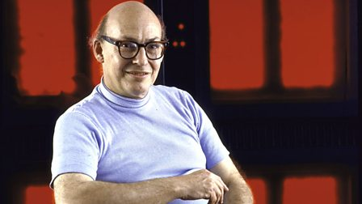
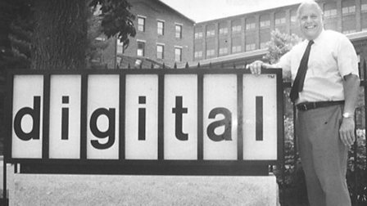
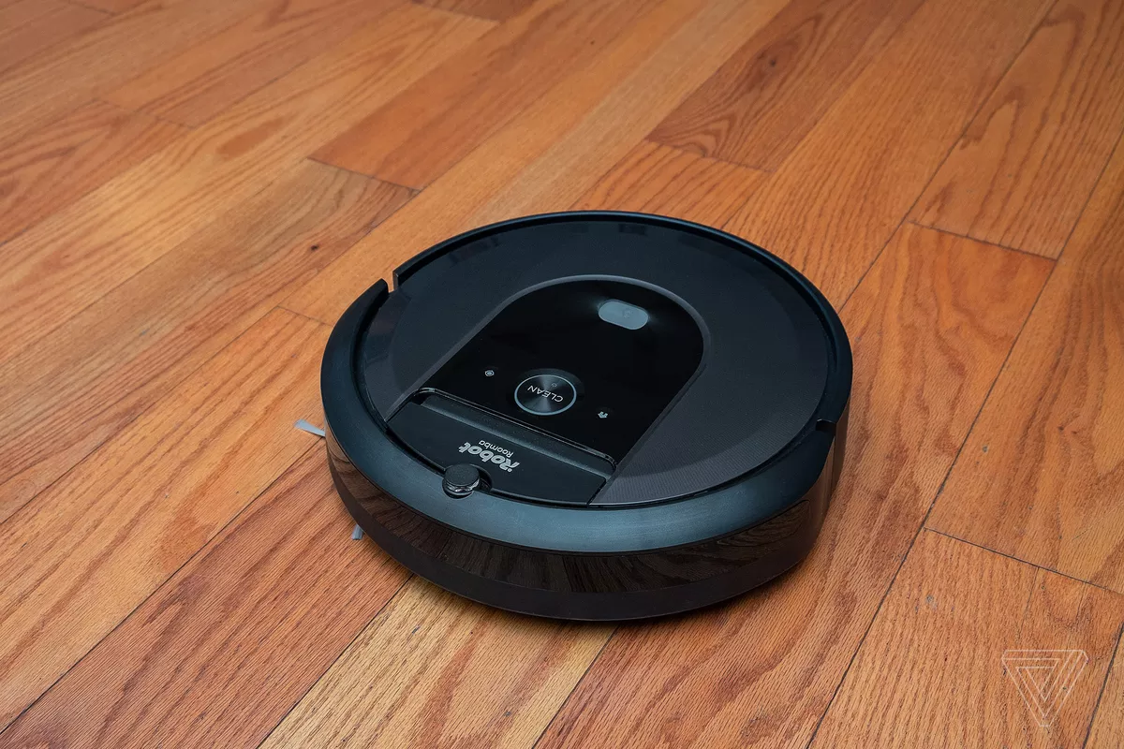
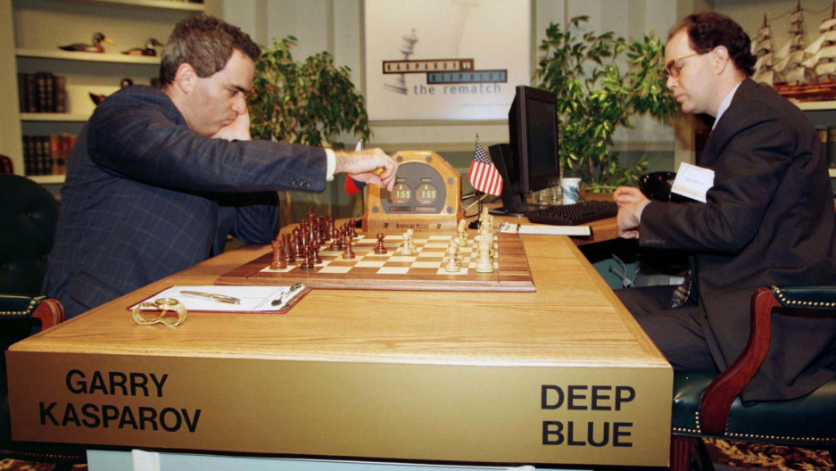
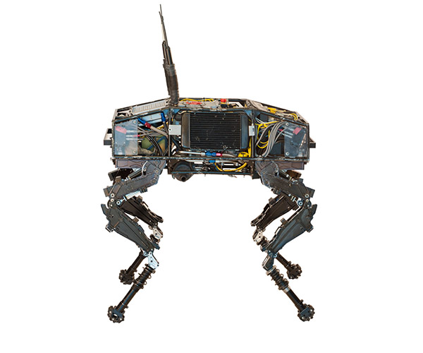
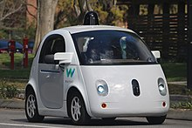
A lot older than you had imagined
1943
Alan Turing and Grey Walter work on “intelligent machines”
1950
Isaac Asimov publishes I, Robot
1950
John McCarthy coins the phrase “Artificial Intelligence”
1968
2001: A Space Odyssey
1969
Shakey the Robot disappoints
1973
The AI Winter & Lighthill Report
1981
Expert systems implemented by Digital Equipment Corp.
1990
Rodney Brooks proposes bio-inspired AI (incl. Neural Nets)
1997
Deep Blue beat Kasparov in Chess
2002
iRobot creates Roomba
2005
Boston Dynamics makes the Big Dog
2008
iPhones first shipped with a speech recognition app
2009
Waymo (self-driving car) founded
2011
Watson took on the Jeopardy champ

Slide 13
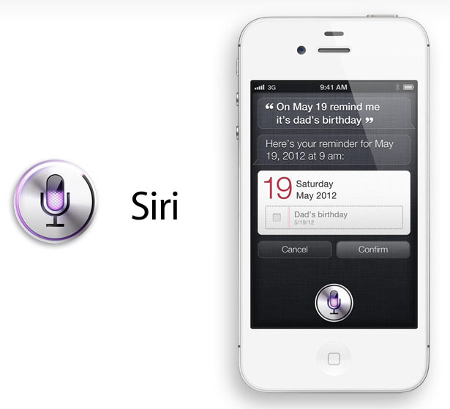
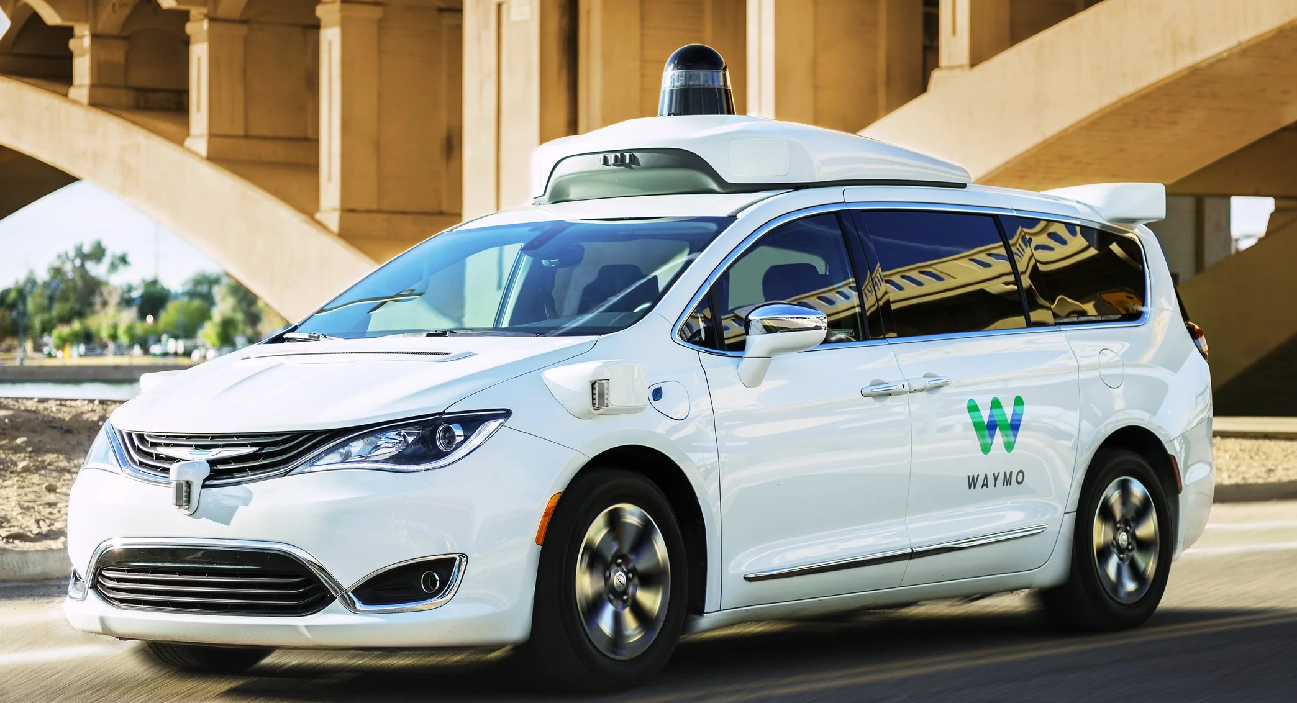
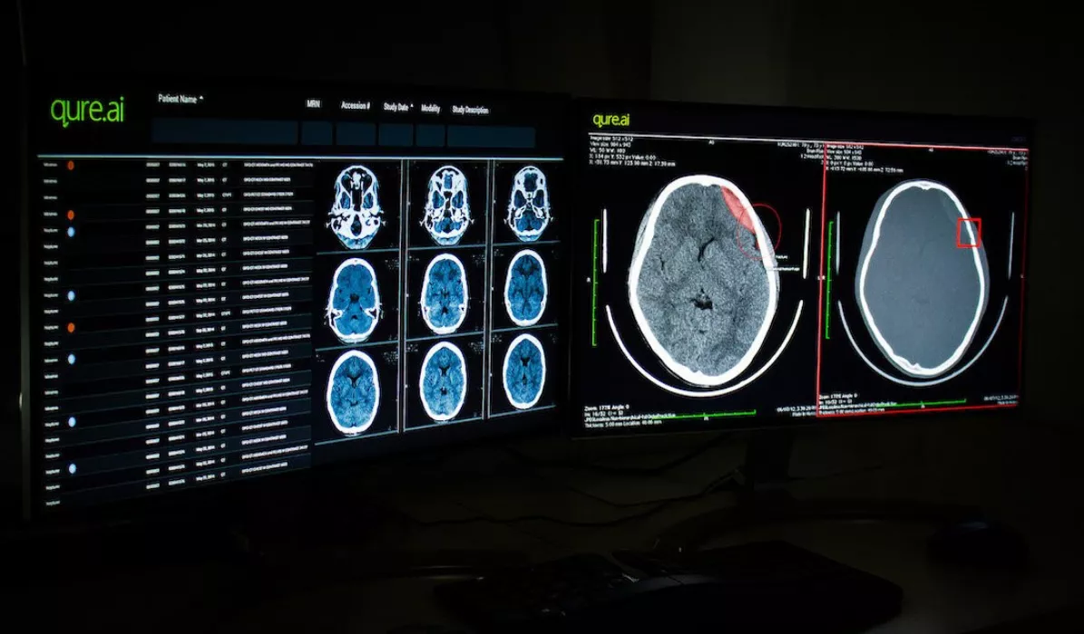
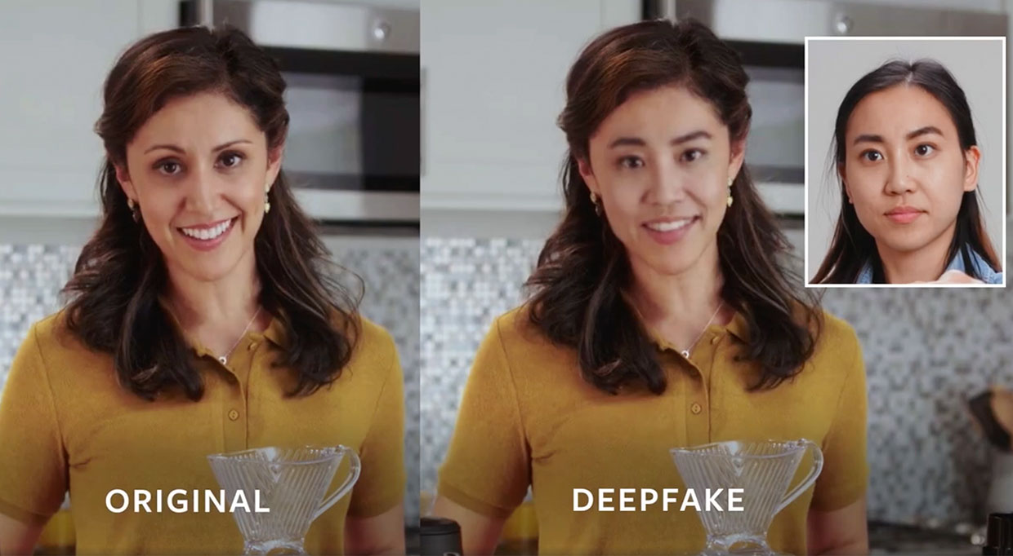
A modern history
2012
Siri, Google Now, Cortana launched commercially
2013
Never Ending Image Learner launched at CMU
2015
AlphaGo started beating humans
2016
AlphaGo beats the Go World Champion
2018
Alibaba language processing outscores humans
2018
Google announces Duplex, voice assistant (generation)
2018
Waymo One public use in Phoenix
2019
Deepfakes – generation & synthesis
2019
Medical diagnosis equal to humans
2019
ALS, MS & Stroke patients communicate

Slide 14
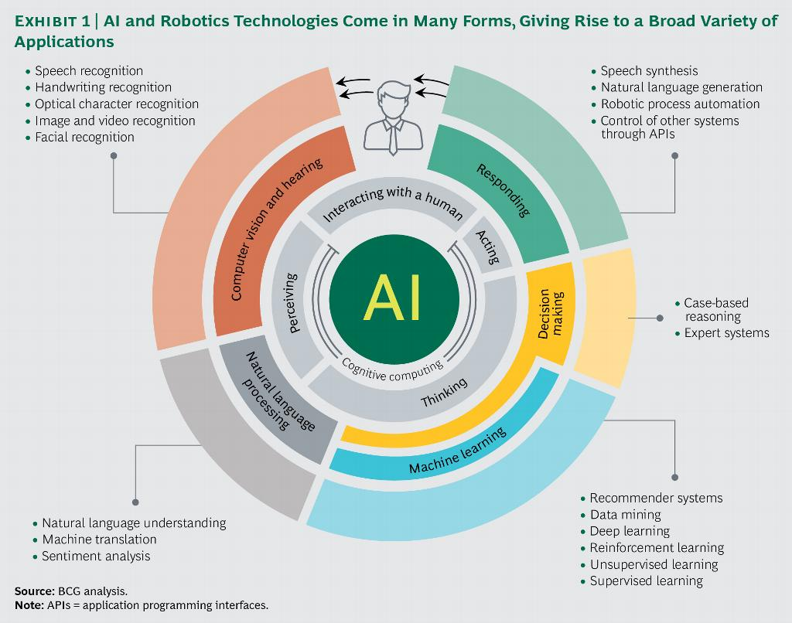
AI demystified

Slide 15
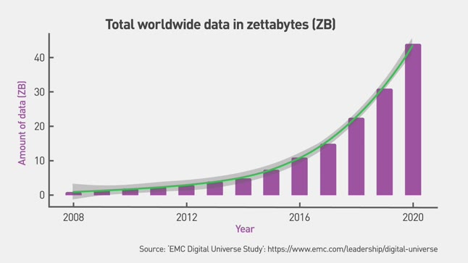
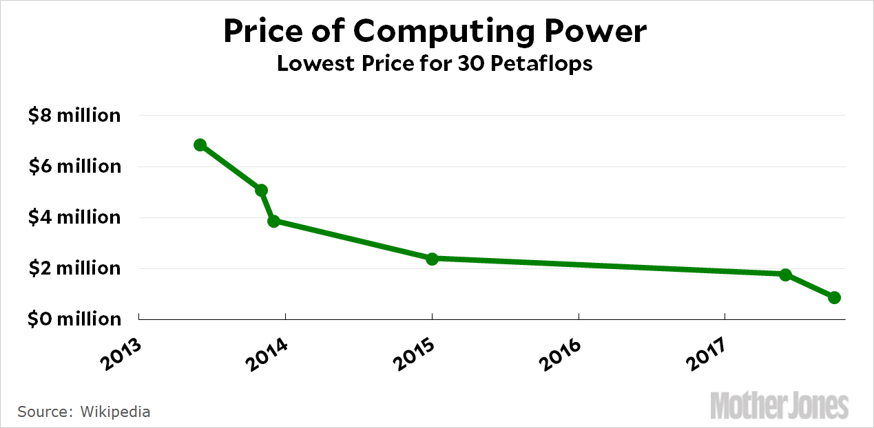
Why is AI suddenly a big deal?
Amount of data being generated
Cost of computing resources

Slide 16
50%
Annual Growth Rate of AI spend
$58B
AI spend by 2021
$31B
Enterprise AI revenues by 2025
84%
% of companies investing in AI
28.5%
Error rate in 2010 for image labeling
2.5%
Error rate in 2017 for image labeling
7B
Number of AI-powered digital assistants 2020
3584
Number of cores in Nvidia’s GPU
14x
Growth in AI startups in the US since 2000
6x
Annual VC investment in AI startups in the US
1/5
Proportion of workers relying on AI by 2021
4.5x
Growth in jobs requiring AI skills since 2013
Notes:
& 2. IDC estimates - https://www.idc.com/getdoc.jsp?containerId=prUS43095417
3. & 4. Statista estimates https://www.statista.com/statistics/607612/worldwide-artificial-intelligence-for-enterprise-applications/
5., 6., 9.10. & 12. AI Index 2017 report (Stanford) - http://cdn.aiindex.org/2017-report.pdf
7. IHS Markit estimate
8. https://www.forbes.com/sites/janakirammsv/2017/08/07/in-the-era-of-artificial-intelligence-gpus-are-the-new-cpus/2/#150c6c664efa
11. Gartner report - https://www.gartner.com/newsroom/id/3837763

Slide 17
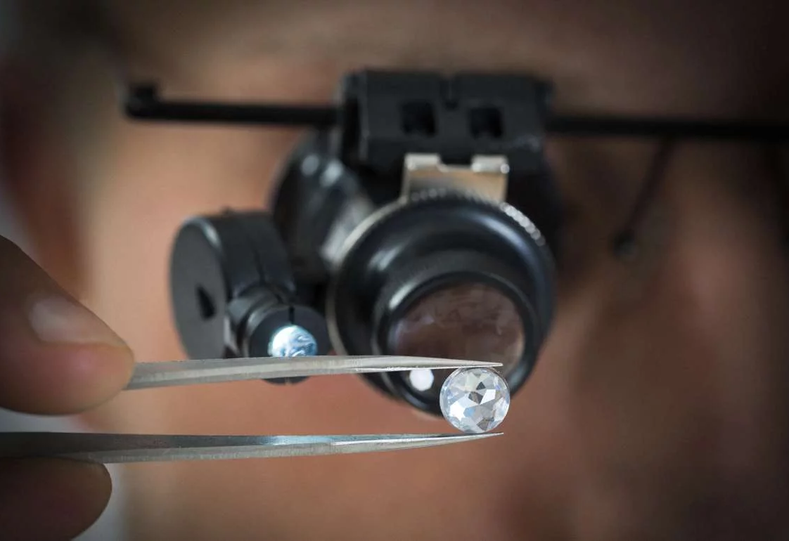
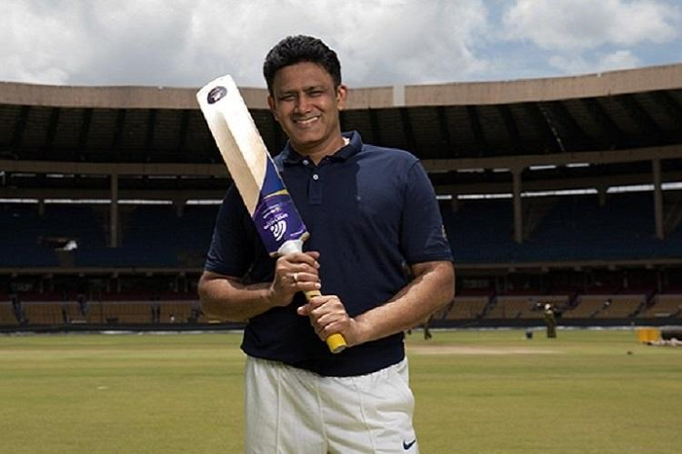
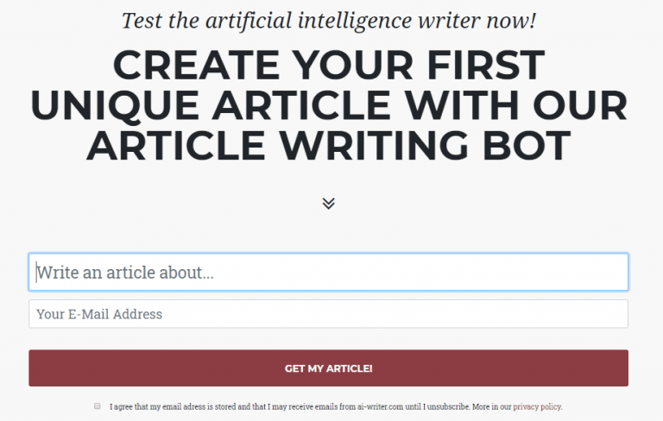
In places you couldn’t imagine
Jewellery
Fighting Fakes
Sports
Smart Cricket Bats
Journalism
Pre-written articles

Slide 18
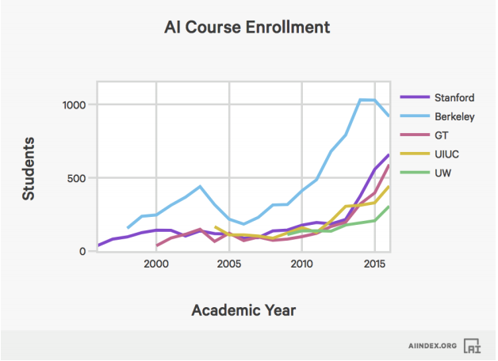
Explains why everyone is learning AI

Slide 19
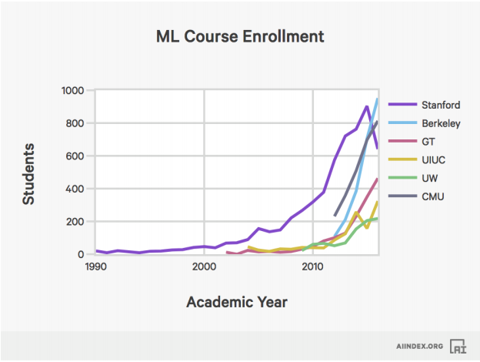
… and ML!

Slide 20
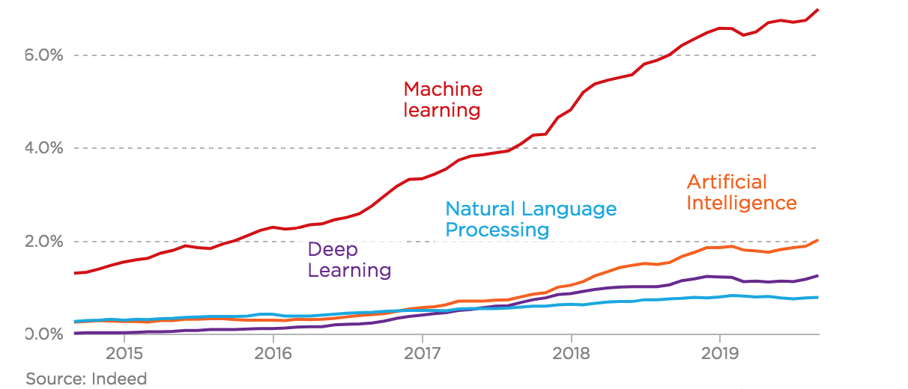
Skills that companies look for
The basics still matter!

Slide 21
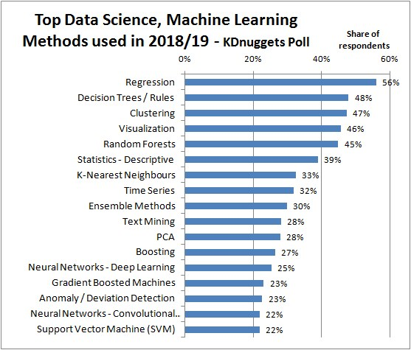
Big divide: Industrial Application vs. Cutting-Edge

Slide 22
The Program

Slide 23
PGP-AIML: The Basics
Your program:
Occurs one weekend every month (alternate months are 3-day residencies)
Each month, the program office will announce the schedule and courses for the upcoming month
The relevant course(s) will be made available on Olympus
Pre-reads and other important information will be posted prior to the class session. Please check and ensure you’ve done the work before the session
Over the course of the program:
You are required to attend all the courses, and complete the corresponding lab sessions in class, and assessments (quiz, projects) out of class.
Class sessions are recorded and available on Olympus
Get very, very comfortable with Olympus !!

Slide 24
PGP-AIML: Program Outline
Foundations
Python for AI & ML
Visualization basics
Statistics & Probability for AI & ML
Machine Learning
Supervised Learning
Ensemble Techniques
Unsupervised Learning
Recommendation systems
Feature Engineering, and Model Selection & Tuning
Decision Making through ML
Deep Learning
Neural Networks
Deep Learning
Tensor Flow, Keras and other libraries
Vision
Deep Learning applied to images using CNNs
Pre-processing, data augmentation
Transfer Learning
Semantic Segmentation, Object Detection
Applications
NLP
Statistical NLP, summarization and similarity measures
Sequence modeling - RNN, LSTM & GRU
Neural Machine Translation & Attention Models
Note: Course sequence and structure is subject to change
Special topics
Reinforcement Learning
Generative Adversarial Networks (GANs)
Projects
Capstone Project
Hackathon
Confidential – For Great Learning use only

Slide 25
In-class and External Labs
Labs
Integral part of the AIML program; Hands on practice for the learners on the topics covered in residency.
In-class Lab: MUST be completed by the end of the class.
External lab: Slightly more advanced, and you have more time to complete and submit these.
Internal labs have lab experts to assist the candidates with their queries
Part of the repository you build
Why Labs?
Learners lacked opportunity to practice their learning of concepts
Learners are expected to solve a business problem related to the concepts taught within fixed timeline

Slide 26
Peer Learning
You
Diverse backgrounds (IT, BFSI, Insurance, Manufacturing, etc.) with varied years of experience (0-25)
May or may not have experience in the field of AI & ML
Program
Curriculum structured to cater to varied audience
Learners with limited experience in the field will have to put in more effort
Learners with experience in ML contribute to others’ learning and strengthen their own perspective

Slide 27
What to Expect
Different faculty with diverse experiences
Mix of theoretical concepts & application
Courses such as Python for Machine Learning, Feature Selection, Model Performance & Hyperparameter Tuning, Statistical NLP and GAN’s are more application-heavy
On average, calibrated so that an hour of work every day should ensure you complete the first 6 months of the program with ease
After 6 months, with the Capstone project running in parallel, an additional 2 – 3 hours of time every week may be needed

Slide 28
Projects
One per course*
Online, at home
Submission by deadline (no extensions)
Individual (or group) effort – no asking for solutions!
Program office support will be limited to clarifications
Main, graded portion of the program
Part of your e-portfolio, and github repository that you will share with the world
Open Data: We try to use a wide range of open data for your projects – that way you can showcase, and share on GitHub.
Also important to benchmark against the world
Expect a non-linear path to project completion
Dead-ends, false starts, errors are all part of the learning process
Program Specialist will clarify the objectives, and troubleshoot any environment issues, but will not provide hints or solutions

Slide 29
Github
All your submissions - lab & project MUST be submitted as an URL of Github link
At the end of the program, showcase all the problems you worked on through your own Github profile
GitHub explanation at the start of the first lab session
Additional FAQ’s and support videos in case of questions
Hackathon
Group hackathon a part of the program
Will combine multiple skills/techniques
Achievement goes in your e-portfolio

Slide 30
Program Office
Program Manager:
First point of call for all program questions – schedule, expectations, etc.
First check Olympus for info before asking PO
NOT 24x7 support, so be realistic about response
Escalation Matrix:
Program Manager
Ujjwal Kumar Singh
ujjwal@greatlearning.in Senior Operations Manager
Rakesh Tiwari
rakesh.t@greatlearning.in GM Operations
director_aiml@greatlearning.in

Slide 31
Prerequisites
As this is not entirely an introductory program, the faculty will assume that you have a functional understanding of:
Programming – you should have the ability to write simple code
High-school mathematics – Elementary stats, probability, matrix algebra.
These will be covered again, but treat the coverage as a refresher
If you do not meet the prerequisites:
Set aside additional time to catch up
Build your own toolkit of background reading/work
Most importantly, reach out to the program office to get support
We are here to support your learning journey

Slide 32
Our Expectations
Patience: Immense heterogeneity, so the program will start slowly, and pick up steam over the coming weeks
Peer Learning: You will learn from and teach each other to reinforce the learning
Consistency: Needing to jump back and forth is very disruptive to the learning experience, so consistently keeping up with the learning outcomes is vital
Trust the process: Learning outcomes are at the heart of the program.
Experience from thousands of learners goes into our decisions
We may not always get it right, but we will make things right
No substitute to practice
How better you get has a direct correlation with how much your practice
Concept of deliberate practice

Slide 33
Notable mentions
Some recent accomplishments of our AIML graduates and learners:
Capstone projects:
Music recommendation engine
Cancer detection (accuracy at par with MIT)
PhD Thesis, Paper submission in journals
Career Success
Facebook Hackathon
Companies: BCG, Deloitte, CTS, HCL, Infosys, SAP, Accenture, Ola Electric, JP Morgan, PWC, American Express, EXL, United Health Group etc

Slide 34
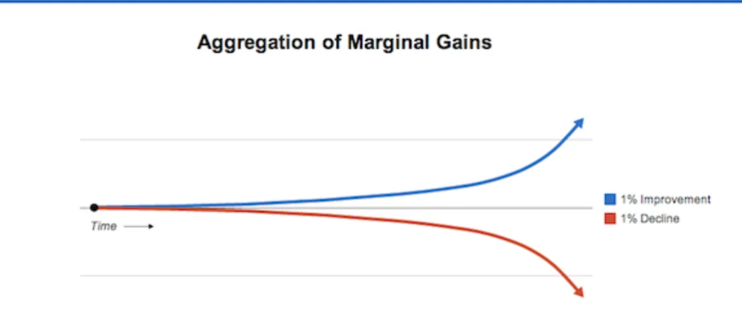
What does success depend on?
Grand success comes from daily marginal gains.
There are no overnight successes and no silver bullets

Slide 35
Good Luck!

